Slide 1
INTELL

Slide 2
Background
Need of Parallelization
GPU technology
Performance and Throughput
Need of the new era.

Slide 3
Performance of CPU and GPU.
CPU and GPU has to work together.
Manual Adjustments (By users)

Slide 4
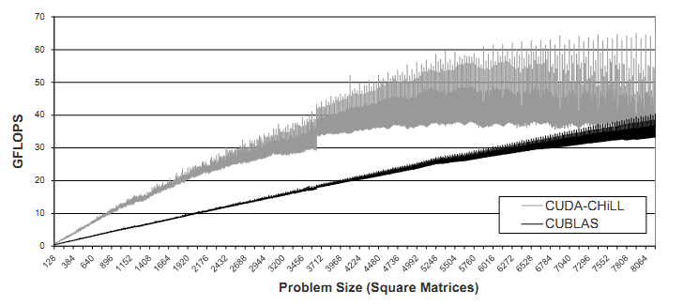
NVIDIA cuBLAS
CUDA-CHILL

Slide 5
INTELL
Whats is INTELL?
INTEgrated tool to paraLLelize and evaluate serial code
Need of INTELL.

Slide 6
Scope
The scope of our project is to provide an interface for CUDA-CHILL and to create a comprehensive test bed for comparing the original c code with the optimized code in terms of performance.
Additionally we may provide multiple GPU compatibility for the GPU compiler framework
Portability
Provide Users to conduct research on WEB.

Slide 7
Scope
Input C Code
Output
CUDA Code
Test Bed
Graph
Interface
CUDA-CHILL
Framework

